Slide 1
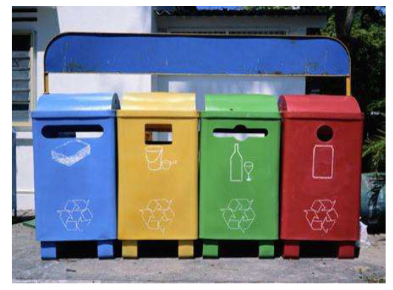
Solid Waste management including Integrated Solid Waste Management (ISWM)

Slide 2
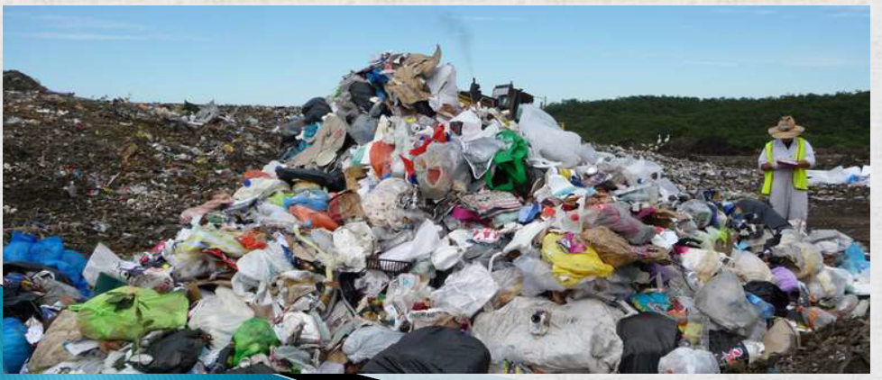

What are Wastes?
It is defined as: Waste is any unwanted or useless materials.
Waste is also known as rubbish, trash, refuse, garbage or junk
In biology, waste is any of the many unwanted substances expelled from living organisms, metabolic waste; such as urea and sweat.

Slide 3
Kinds of Wastes
Solid wastes: wastes in solid forms, domestic, commercial and industrial wastes Examples: plastics , bottles, cans, papers, scrap iron, and other trash
Liquid Wastes: wastes in liquid form Examples: domestic washings, chemicals, oils, waste water from ponds, manufacturing industries and other sources.
Bio-degradable :can be degraded (paper, wood, fruits and others)
Non-biodegradable :cannot be degraded (plastics, bottles, old machines, cans, Styrofoam containers and others)
Hazardous wastes: Substances unsafe to use commercially, industrially, agriculturally, or economically and have any of the following properties- ignitability, corrosivity, reactivity & toxicity.
Non-hazardous : Substances safe to use commercially, industrially, agriculturally, or economically and do not have any of those properties mentioned above. These substances usually create disposal problems.

Slide 4
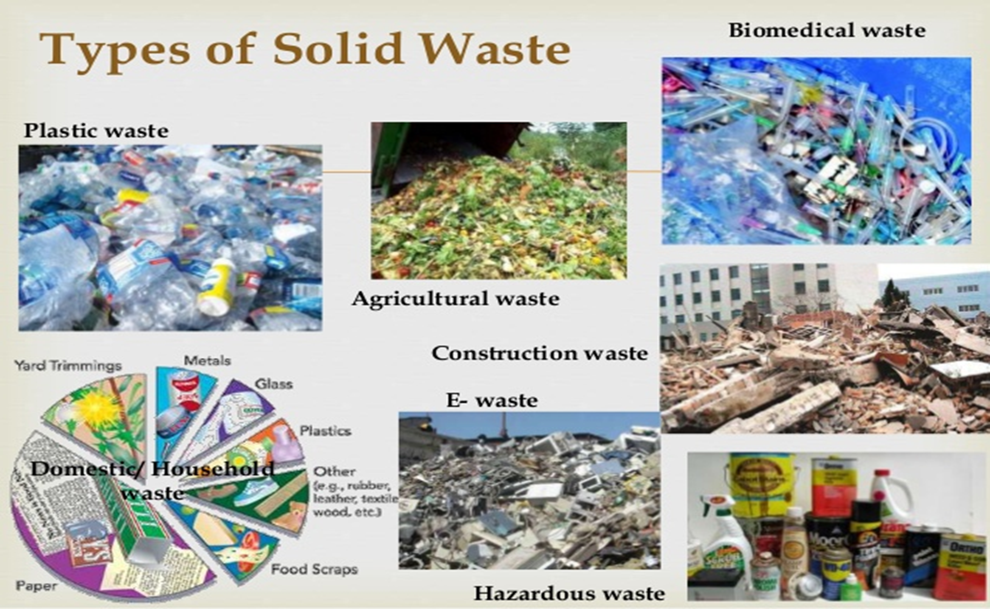

Slide 5
Solid waste
Definition
All solid and semisolid wastes, arising from human and animal activities, and which are discarded as useless or unwanted, are called Solid Wastes or Refuse.
This definition excludes human excreta and sullage (liquid waste from kitchen and bathroom).
In normal life, solid wastes are seen in two common forms:
Rubbish: It include combustible (e.g., paper, card board, textile, plastic, rubber,
wood etc.) and non-combustible (glass, crokery, metals, construction wastes etc.)
solid wastes.
Garbage: It includes putrescible (that can rot) organic wastes, e.g., residue of fruits, vegetable and animals which are generally produced in cooking and eating of foods.

Slide 6
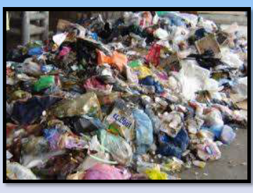
Types and Sources
There are three categories of soil wastes:
Municipal Wastes: These wastes arise from residential areas (household activities, streets), commercial areas (hotels, markets, institutions) and community areas (streets, parks, play ground).
Industrial Wastes: These wastes arise from industrial activities and include rubbish, ashes, construction wastes, toxic wastes etc.
Hazardous wastes: These are highly harmful wastes arising from hospitals, industries, nuclear plants, research institutions, laboratories and include biological wastes, toxic chemicals, radioactive substances, explosives and flammable wastes.

Slide 7
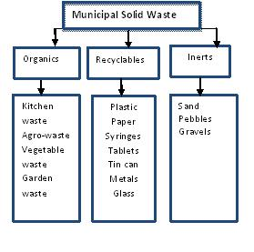

Slide 8
Cause of increasing solid waste generation
Overpopulation and thereby increasing consumption and waste generation
Technological advancement leading to cheap production of commodities
Rapid urbanization and increasing availability of consumer products
Growing trend of “non-returnable packaging” and “use and throw” culture
Increasing purchasing power of public which lead to increasing consumerism, affluence and luxury

Slide 9
Effects of solid waste pollution
Pathogens of different diseases arise from the wastes and spread diseases
Solid waste may choke drains and pits which result in water logging and breeding of mosquitoes
Stray animal (dogs, cattle) feed on the garbage, spread it and also fall ill
Pollutants from garbage dump contaminate ground water and surface water
Garbage dumps often destroy aesthetic value of the locality
Fumes arising from burning of wastes pollute the air and foul smell due to decomposition of organic wastes create are unpleasant and create health problems

Slide 10
Solid waste management
With growing rate of solid waste generation all over the world, solid waste management has become one of the major necessities of the society, particularly in urban areas.
There are three parts of solid waste management:
Collection
Disposal
Recovery

Slide 11
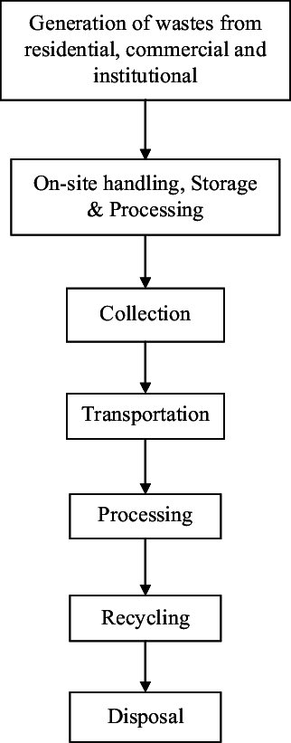
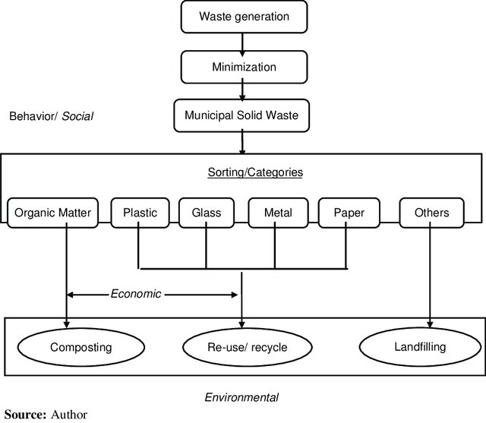
Solid waste management

Slide 12
Solid waste management
A. Collection
It involves collection of solid waste from the point of generation and its transportation to disposal site.
Households usually collect their waste in dust bins and throws it in community storage place from where municipality or similar body pick it up and transport to disposal site.

Slide 13
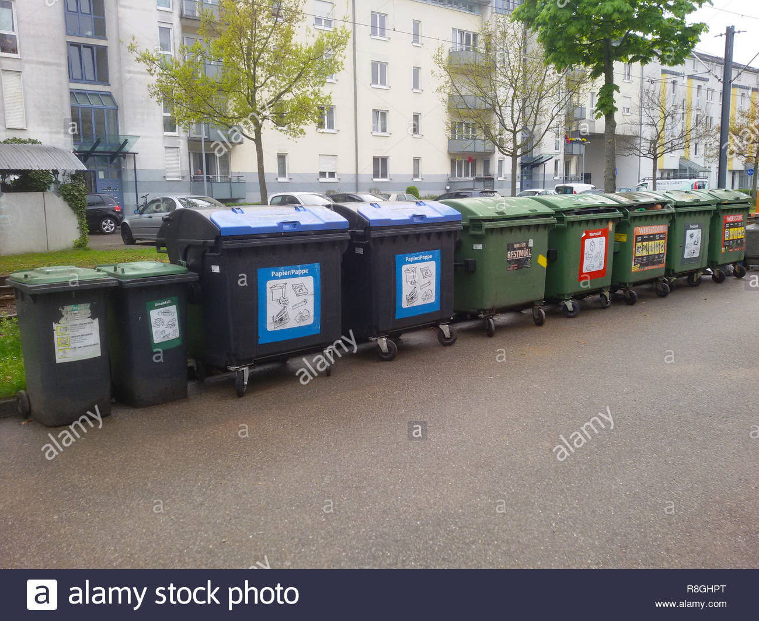
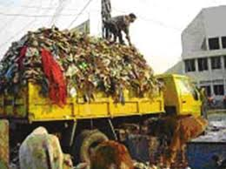
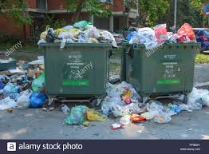
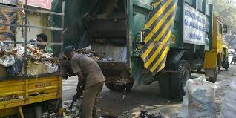
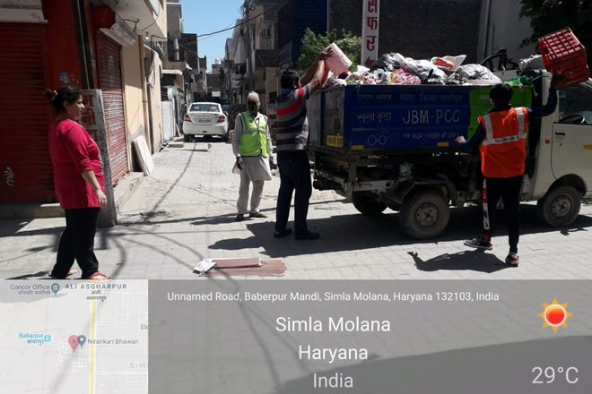

Slide 14
Solid waste management
B. Disposal
Disposal means processing of waste so as to get rid of it. It also means to reduce volume, harmful effect and unpleasant appearance of solid waste. The collected solid waste is disposed in one of the following ways:
Open dumping
Waste is deposited in low laying land, usually on out skirt of town.
No further processing is done. This is cheap and easier method, but it causes air and water pollution and health hazards.
Open dumping is commonly applied for disposing of community waste in many towns of India.

Slide 15
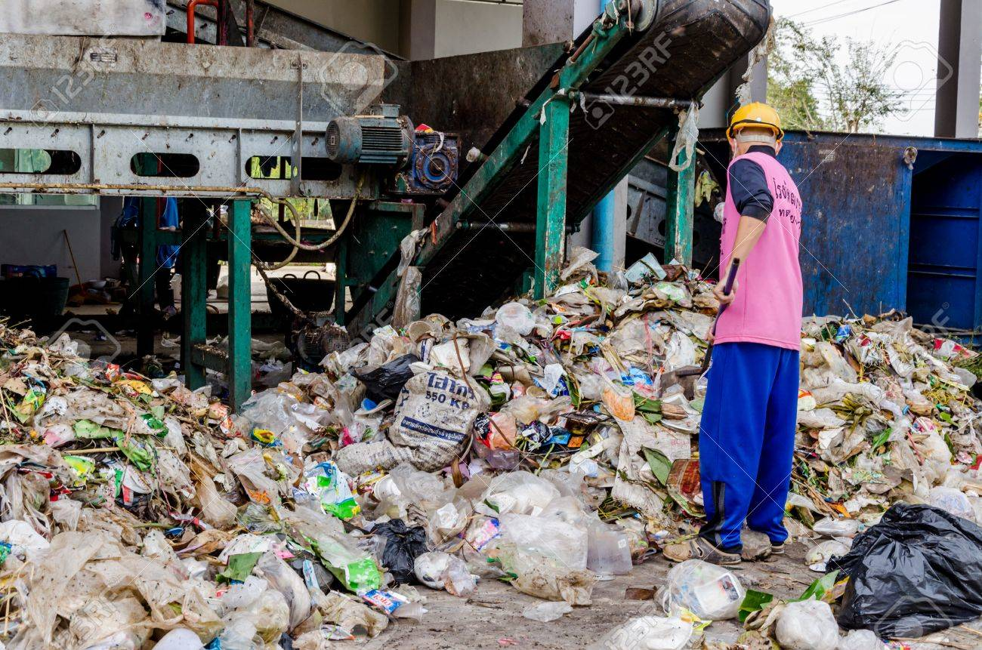

Slide 16
Solid waste management
Sanitary land-filling
This is modified form of open dumping in which waste is deposited in layers of about 1.5 m thickness. These layers are covered with soil (20 cm) and compressed by bulldozers. Insecticides like DDT are sprayed on top layer to prevent mosquitoes and flies. The waste undergoes decomposition, stabilizes within a period of 2-12 months and settles down by 20-40% of its original volume.
Sanitary land-filling is applied for disposing of municipal waste in metros and big cities of India.
This method is simple, economical, does not require skilled labour and costly equipment, does not involve segregation or further processing, and can be done to reclaim low-lying areas.
Negative aspects include large area requirement, soil requirement for covering, and use of insecticides and risk of ground water pollution.

Slide 17
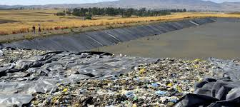
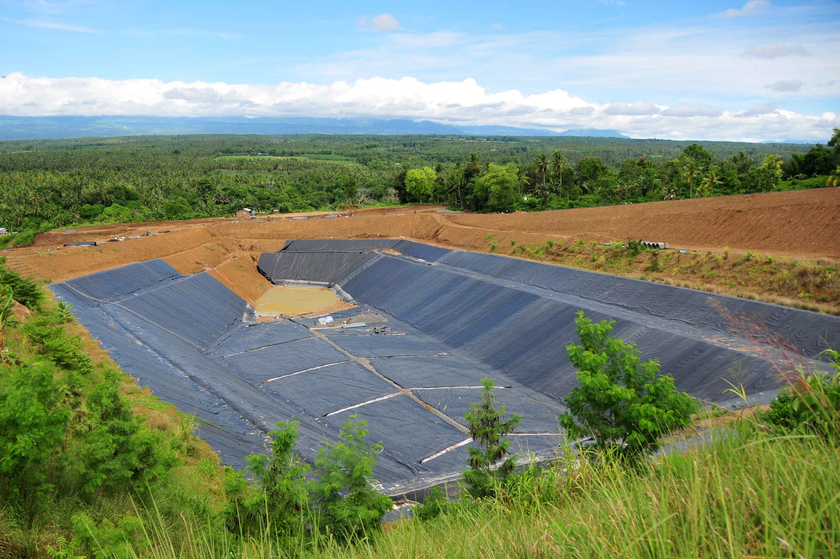

Slide 18
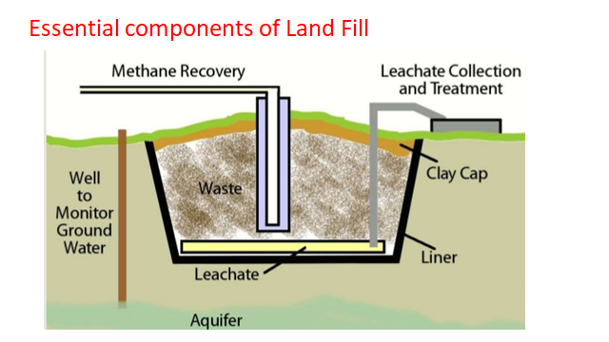

Slide 19
Solid waste management
Composting
It involves biological decomposition of organic substances available in waste, under controlled conditions. It operates in both aerobic and anaerobic conditions. As a result of this volume and harmful effects of waste is reduces. The residue of the process is organic manure which contains minerals and can be applied in agriculture as fertilizer.
There are three common methods of composting: (i) Trenching based composting (ii) Open window composting and (iii) Mechanical composting.
Composting is practiced since long in India and it is the best suited to our environment. Composting is an ecofriendly method in which wastes are finally converted into simple compounds of nature. It produces valuable manure which protects soil fertility and reduces soil erosion. It can be practiced even a household level.
Negative aspects or limitations include its slow processing, production of unpleasant smells, and its applicable only for bio-degradable wastes.

Slide 20
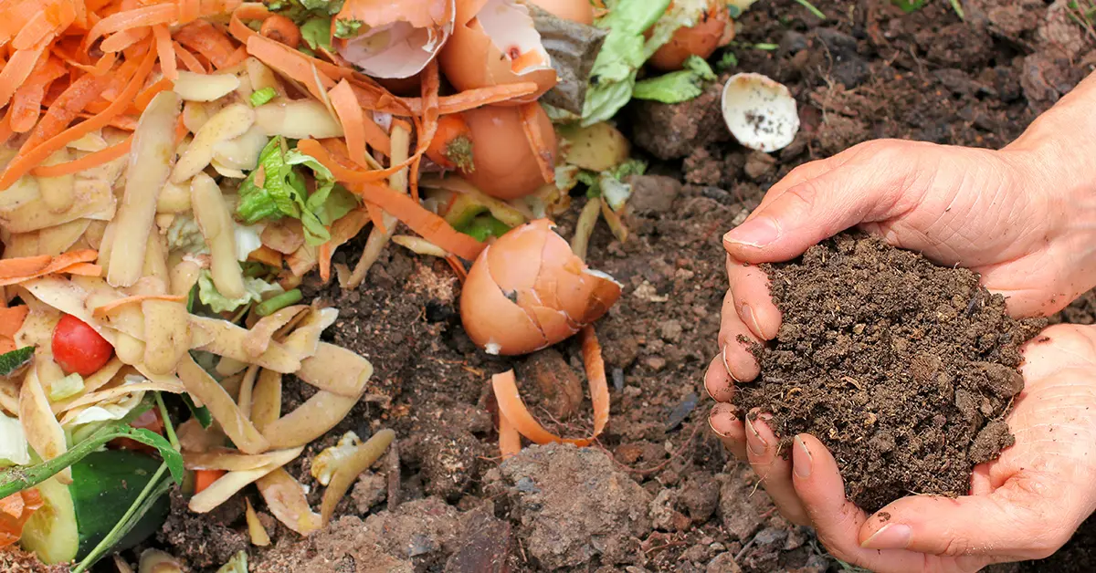

Slide 21
Solid waste management
Incineration:
Waste is burnt in controlled manner, at high temperature (700⁰-1000⁰C) in a large furnace known as incinerator. Prior to burning non-combustible items (e.g., metals, glass, crockery etc.) are segregated and removed. The combustion process produces CO₂, N₂ and water vapour. Waste reduces to ash which is only 10% of original volume.
Incineration is commonly adopted for disposing of hazardous toxic waste in
India. It is more common in developed countries.
This method is quick, require little space, involve less transportation cost, highly reduce volume of waste and provide safest disposal.
Negative aspects include high capital (initial) and operating cost, need of skilled manpower and air pollution. Besides it, segregation of waste and final disposal of ash is also required.

Slide 22
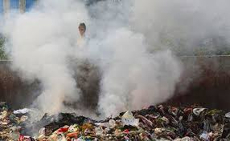
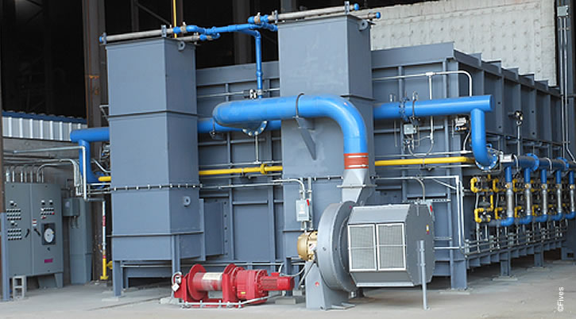
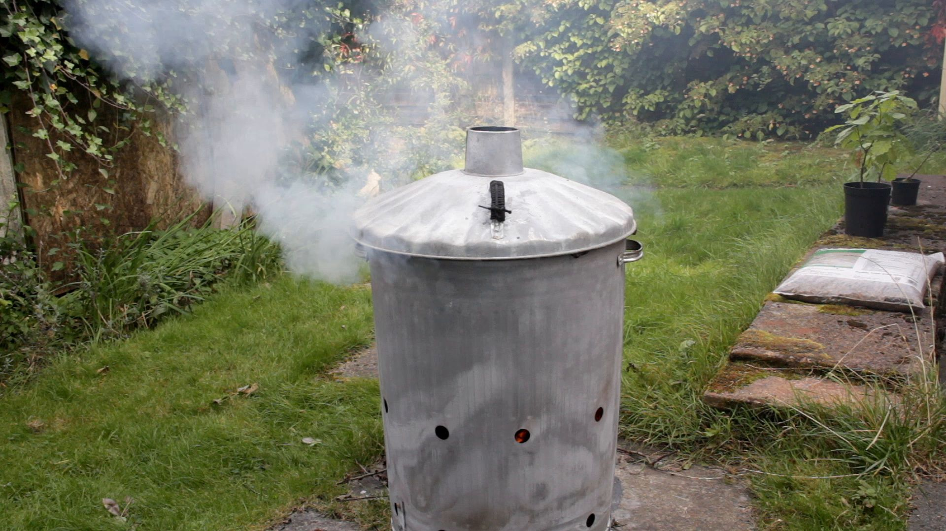
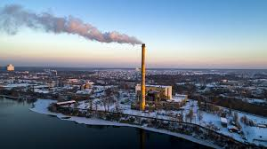

Slide 23
Solid waste management
Pyrolysis or destructive distillation
In this method waste is heated at high temperature (700⁰-1000⁰C), but in anaerobic conditions (low or no O₂). Unlike incineration, Pyrolysis is exothermic process which is meant to recover chemical energy of organic wastes. The process converts organic wastes into CO, CO₂, CH₄, tar etc.
It is less frequently applied method in India. Its merits and demerits resembles to that of incineration.
Pulverization
In this method waste in converted into powder by mechanical grinding. This reduces volume of the waste and changes its physical character. This is further disposed of by land-filling.
Due to high capital and running cost, it is not common in India.

Slide 24
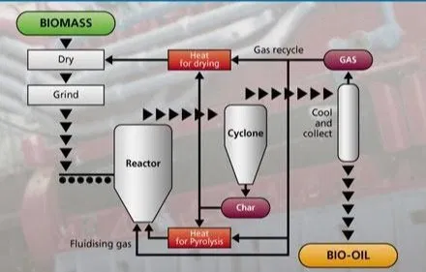
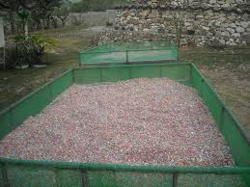

Slide 25
Solid waste management
Disposal into sea
This method is adopted in coastal areas which have deep sea water (>30 m) at a moderate distance (<16-20 km) with strong forward current.
This is cheap method that can be adopted in coastal areas.
Negative aspects include limited applicability for coastal areas, spoiling of sea beaches due to return of wastes to coasts, and difficulties during monsoon and storms.

Slide 26
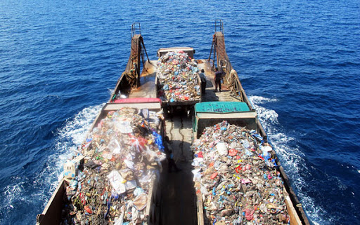
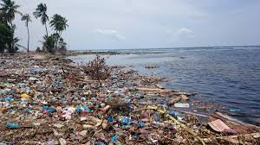

Slide 27
Solid waste management
C. Recovery of materials
The material present in waste can be recovered and utilized for useful purposes i.e., the waste is converted into resource. Two common strategies are used for this:
Reuse
Recycling
It means using the waste material in some or other ways without much reprocessing. e.g., making rubber rings from discarded cycle tubes which can be used by newspaper vendor instead of rubber bands.
Recycling means reprocessing of discarded materials into new useful products. Paper and other cellulose products are commonly recycled to make recycled paper and card board. Metallic wastes are recycled by melting and recasting into new items.

Slide 28
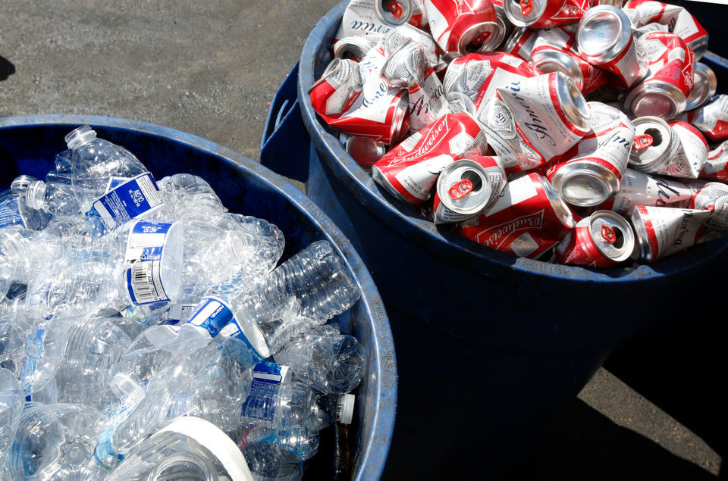
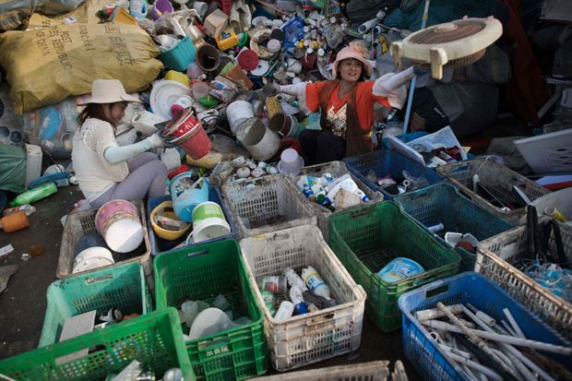
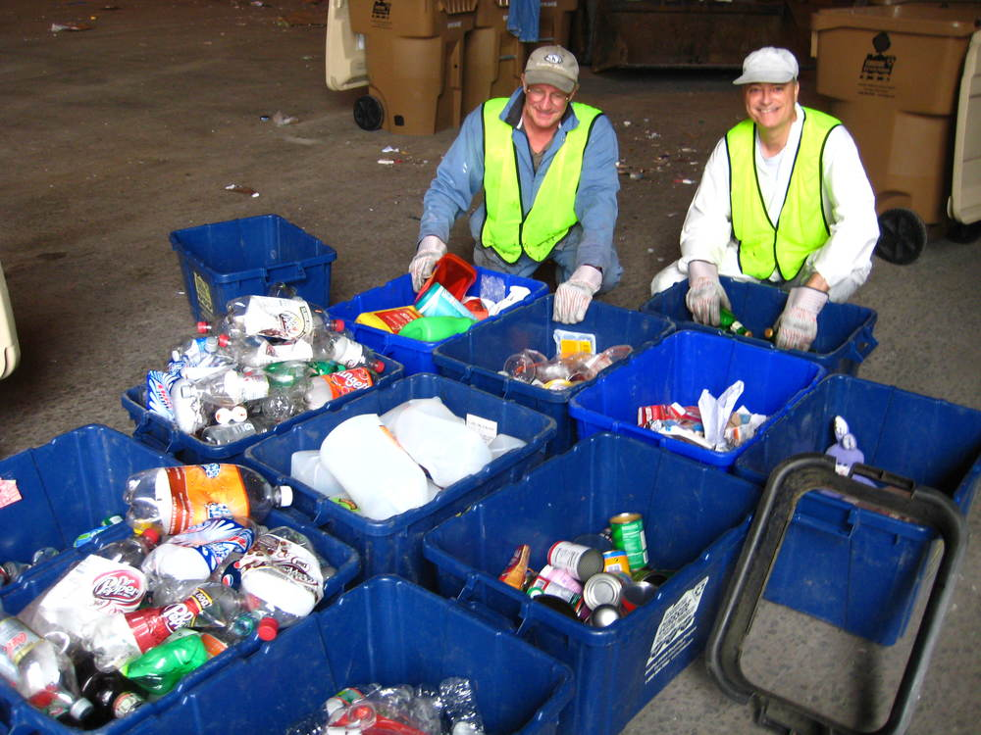
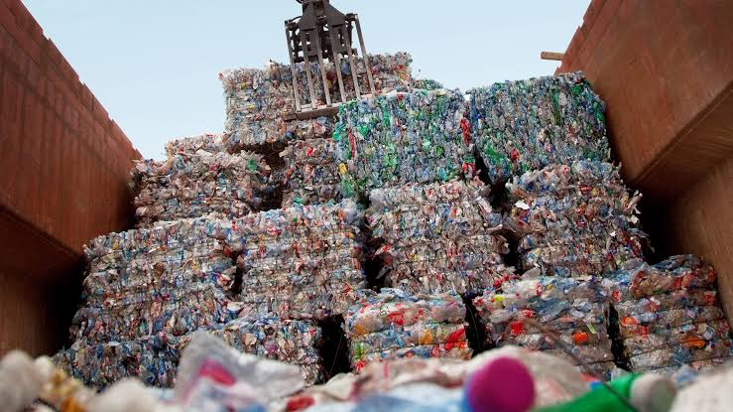

Slide 29
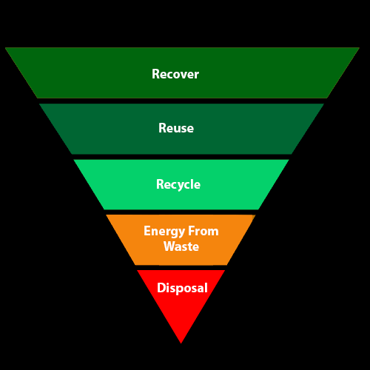

Slide 30
Numerical Solid waste Management
Compute the landfill area requirement for 20 years of a city with population of 10 lakh. (Given: MSW generation = 500 gm per capita per day; MSW density = 500 kg/m3).
Solution: total time = 20 year= 20x365 day
Total population = 10 lakh; MSW generation = 500 gm (= 0.5 kg) per capita per day
Thus total mass of MSW generation in 20 years by 10 lakh people
= 0.5kg/day/p x10,00000p x20x365day = 3650000000kg = 36.5x10⁸kg
Given MSW Density = Mass/volume = 500kg/m³ (1)
Putting earlier calculated mass in equation 1
36.5 x10⁸ kg/volume= 500kg/m³
Volume of landfill required = 36.5 x10⁸ kg/500kgm⁻³ = 73,00000 m³
Assume height of land fill is 10 m
Thus area of land fill = total volume of land fill/ height= 73,00000 m³/ 10m = 73,0000 m²
Since in a landfill total land requirement = land required to dump solid waste+ same amount of land required to construct road for vehicle movement
Thus total land requirement = 73,0000x2 = 1,460,000 m²

Slide 31
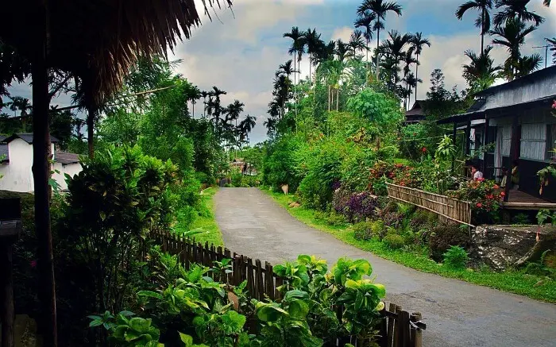
Cleanest village in Asia – Mawlinnong, Meghalay, India

